Slide 1

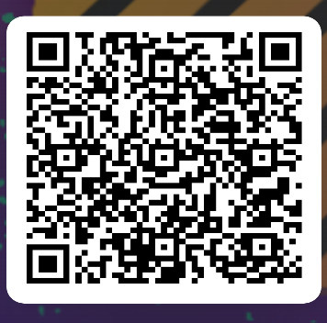

SEB Stats Workshop Overview of Stats process
Please check in
Register:
Materials and code:
Notes:
Introduce ourselves

Slide 2

Outline for today
Morning
Lecture [1.5 hours, including Q&A]
Stats basics
Overview of Stats process
Worked example in R
[1.5 hours, including Q&A]
GET CODE HERE:
https://github.com/hahnp13/Workshops.git
Notes:
Allen start

Slide 3

ALS6502C Course Manual
https://hahnp13.github.io/ALS6502C-LMANR-Manual/

Slide 4
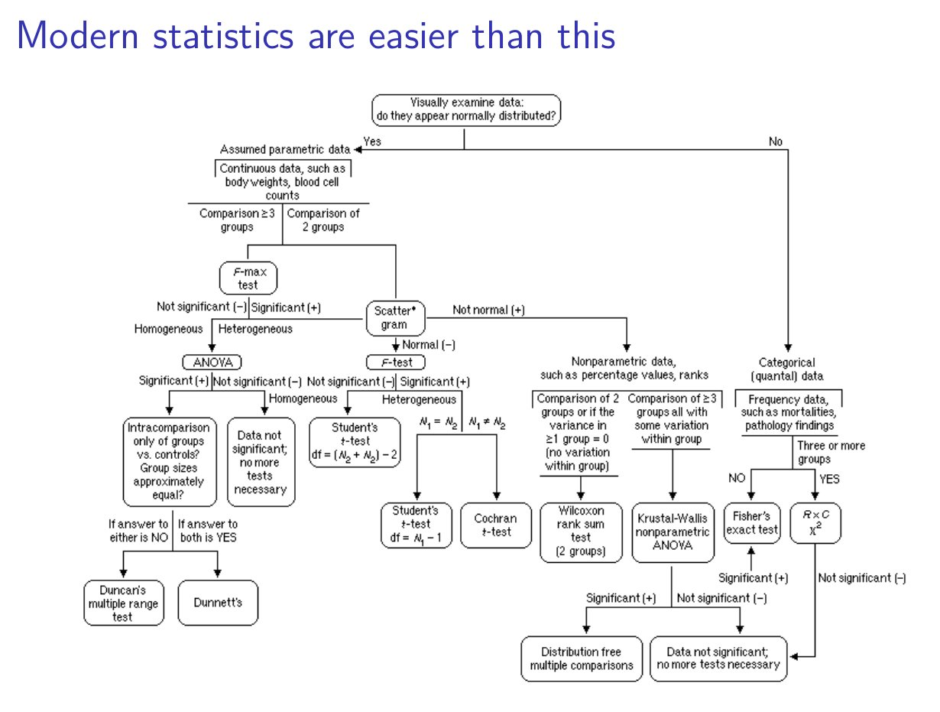
Francisco Rodriguez-Sanchez https://frodriguezsanchez.net

Slide 5
Francisco Rodriguez-Sanchez https://frodriguezsanchez.net

Slide 6
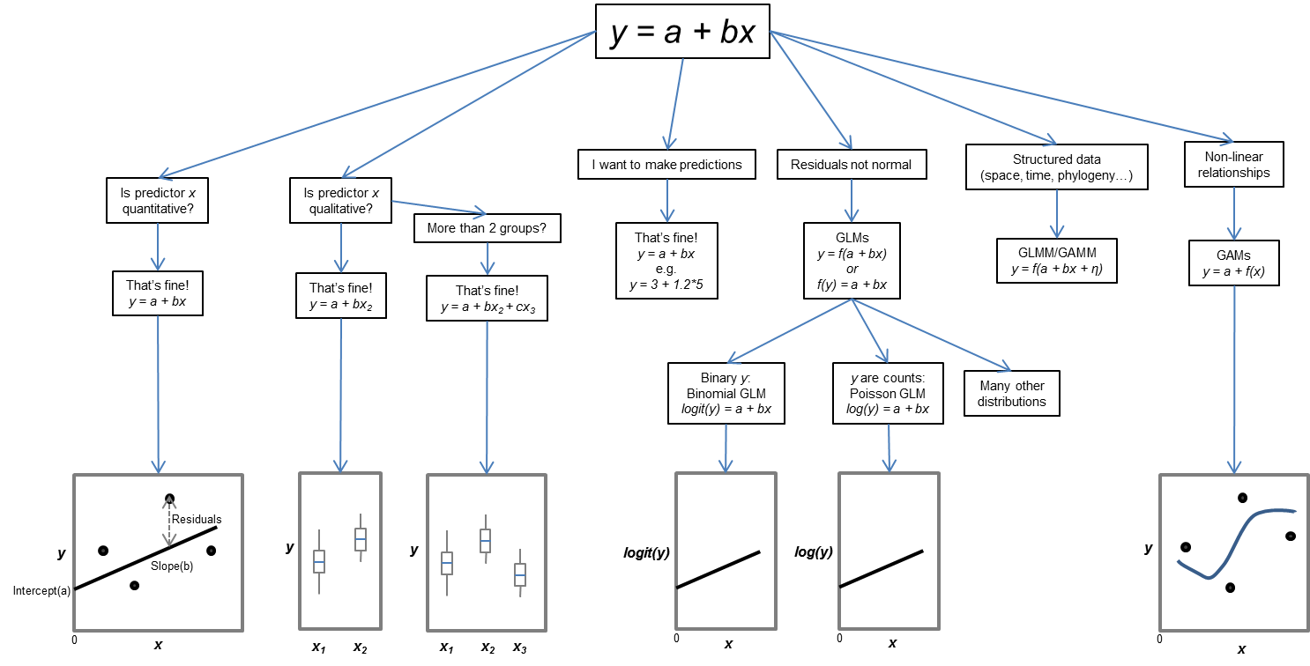
Francisco Rodriguez-Sanchez https://frodriguezsanchez.net

Slide 7


Slide 8
What is a probability distribution?
A measure of how spread out the data values are from the mean
A mathematical description of a random phenomenon that gives the probability of possible events
A summary statistic that describes the center of a data set
An estimate of the variability, or precision, of a sample mean

Slide 9
What is a probability distribution?
A measure of how spread out the data values are from the mean
A mathematical description of a random phenomenon that gives the probability of possible events
A summary statistic that describes the center of a data set
An estimate of the variability, or precision, of a sample mean

Slide 10
What is a mean?
A measure of how spread out the data values are from the mean
A mathematical description of a random phenomenon that gives the probability of possible events
A summary statistic that describes the center of a data set
An estimate of the variability, or precision, of a sample mean

Slide 11
What is a mean?
A measure of how spread out the data values are from the mean
A mathematical description of a random phenomenon that gives the probability of possible events
A summary statistic that describes the center of a data set
An estimate of the variability, or precision, of a sample mean

Slide 12
What is a standard deviation?
A measure of how spread out the data values are from the mean
A mathematical description of a random phenomenon that gives the probability of possible events
A summary statistic that describes the center of a data set
An estimate of the variability, or precision, of a sample mean

Slide 13
What is a standard deviation?
A measure of how spread out the data values are from the mean
A mathematical description of a random phenomenon that gives the probability of possible events
A summary statistic that describes the center of a data set
An estimate of the variability, or precision, of a sample mean

Slide 14
What is a standard error?
A measure of how spread out the data values are from the mean
A mathematical description of a random phenomenon that gives the probability of possible events
A summary statistic that describes the center of a data set
An estimate of the variability, or precision, of a sample mean

Slide 15
What is a standard error?
A measure of how spread out the data values are from the mean
A mathematical description of a random phenomenon that gives the probability of possible events
A summary statistic that describes the center of a data set
An estimate of the variability, or precision, of a sample mean

Slide 16
Questions ???
Materials and code:
Notes:
Allan

Slide 17
What is a probability distribution?
Normal (Gaussian) distribution
Continuous numeric variables
-∞ to ∞
Most points near the mean
Points symmetrically distributed around mean

Slide 18
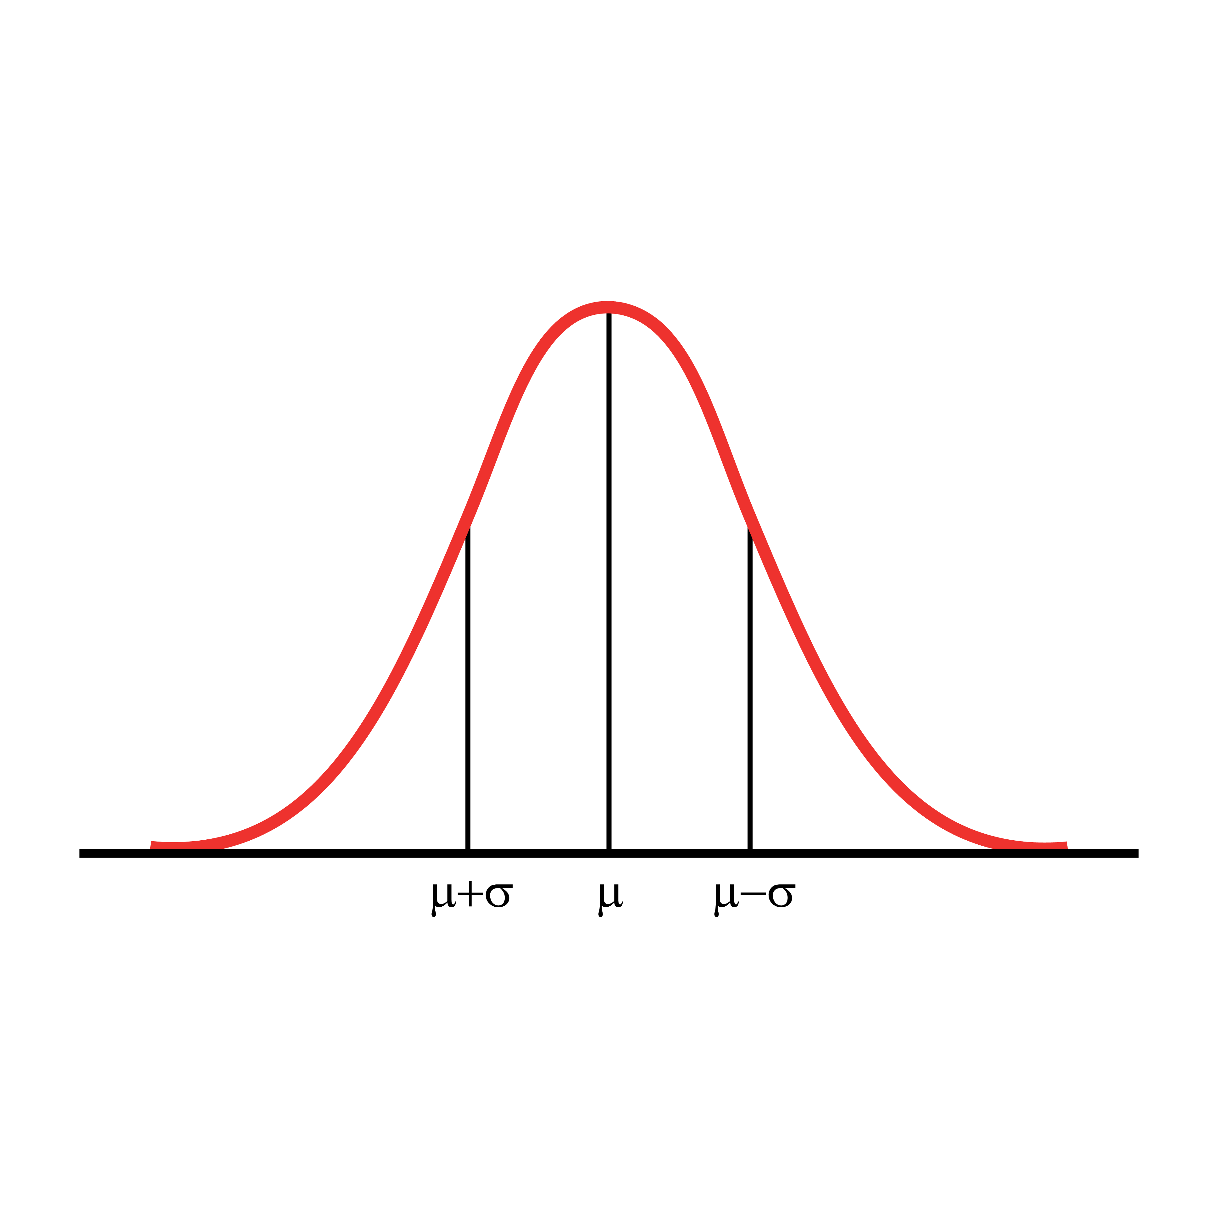
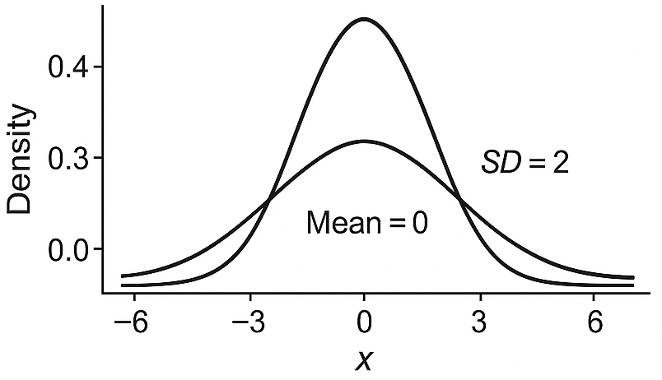
What is a probability distribution?
Normal (Gaussian) distribution
Continuous numeric variables
-∞ to ∞
Most points near the mean
Points symmetrically distributed around mean
Parameters
μ = Mean
σ² = Variance
σ = Standard deviation
SD = 1

Slide 19







What processes generate data?
Data are the result of natural (or biological) phenomena
Counts
Proportion
Time-to-Event

Slide 20

What processes generate data?
Data are the result of natural (or biological) phenomena
Phenomena is mathematically described by a probability distribution
Data we observe are a random subset of events produced by a phenomenon
Used to model data in statistical analysis and make inferences
Natural processes
Probability distribution
Observed data
Model / inference
count
Predictor variable

Slide 21
Steps for constructing and interpreting a GLMM
0. Data Exploration
Construct model
Fixed effects (predictor or explanatory variables)
Random effects (blocking variables)
Error distribution (response variable or dependent variable)
Assess residuals and overdispersion
Check random effects and/or distribution using AIC (not always needed)
Examine significance of terms in model
Anova
AIC model selection
Calculate treatment means and/or slopes
Construct contrasts
Calculate R2m and R2c
Make pretty figure
Notes:
Allen end

Slide 22

Step 0: Data exploration
Formulate biological hypothesis Carry out experiment & collect data
Data Exploration
Apply statistical model
Use to choose an appropriate model and avoid assumption violations

Slide 23

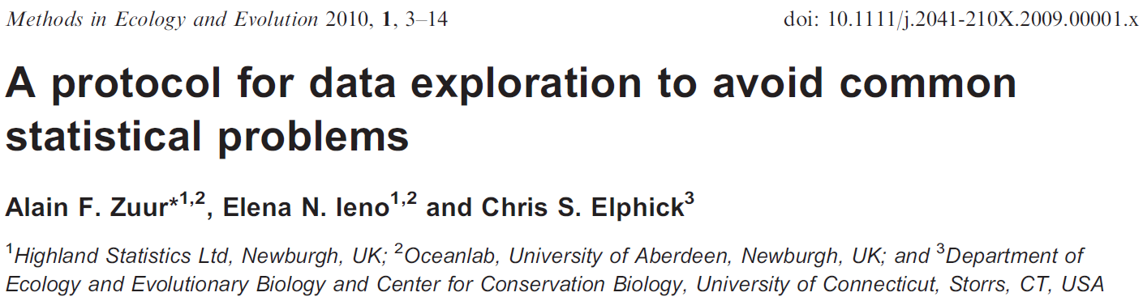
Step 0: Data exploration
Formulate biological hypothesis Carry out experiment & collect data
Data Exploration
Apply statistical model
Understand design & variables
Explore data
Values & Outliers
Distribution & Variance
Collinearity
Relationships / Interactions
Independence / Clustering
Document decisions

Slide 24


Know your data and design
Get familiar with your dataset!
What is the response? What are predictors?
Units, scales, coding
Sampling design, repeated measures, groups
Explaining my datasheet to my colleagues
Toolbox
Summary statistics; frequency tables; generalized pairs plot

Slide 25
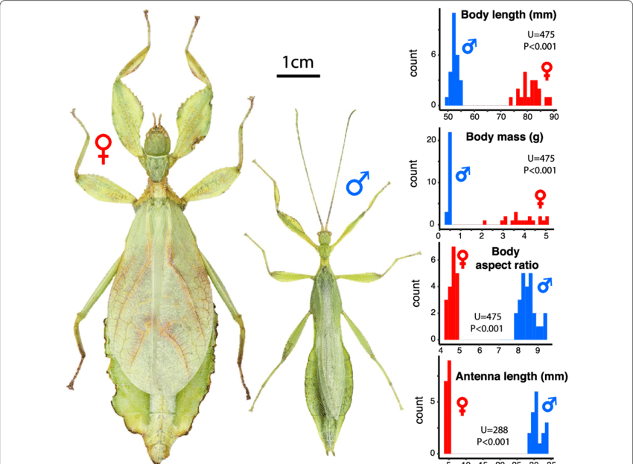
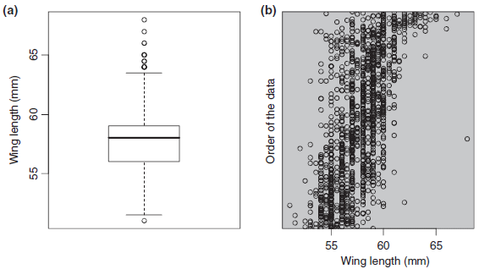

Explore Data - Values & Outliers
Spot “impossible values” & data errors
Outliers / fringeliers → Investigate
Toolbox
Histograms; box/violin/bean plots; dotplots; scatterplots
Investigate Subgroups
(e.g. season or sex) to see whether there are differences among subsets of the data.

Slide 26
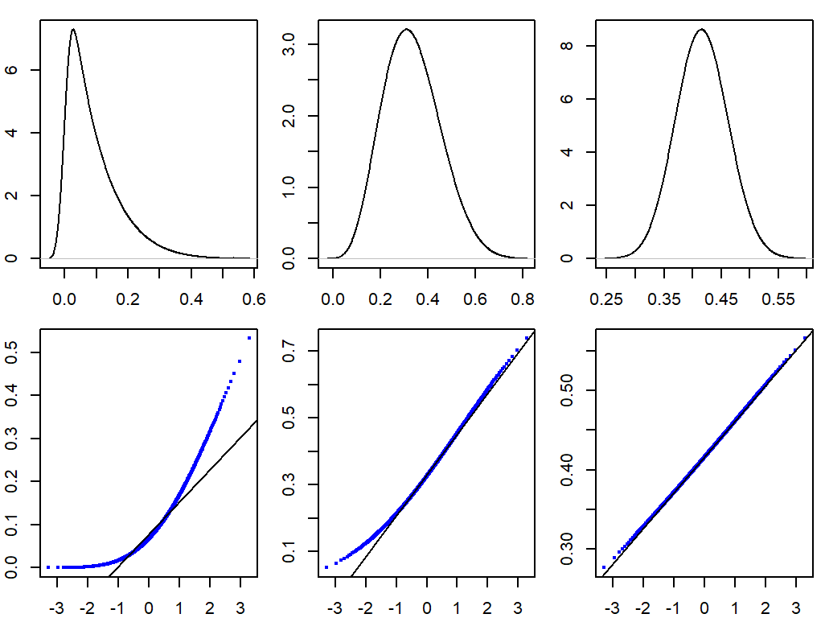
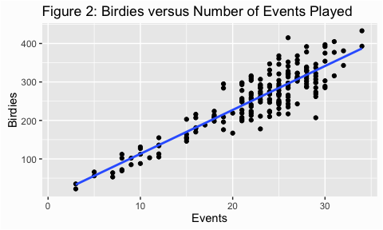
Explore Data - Distribution & Variance
Normality, skew, heteroscedasticity, …
Response: skew, zeros, heavy tails
Predictors, floors/ceilings
Plot against reference distribution
Use exploration to guide choices: distribution, transformations
Toolbox
Histograms; density; (conditional) line plots box/violin/MD; QQ plots

Slide 27
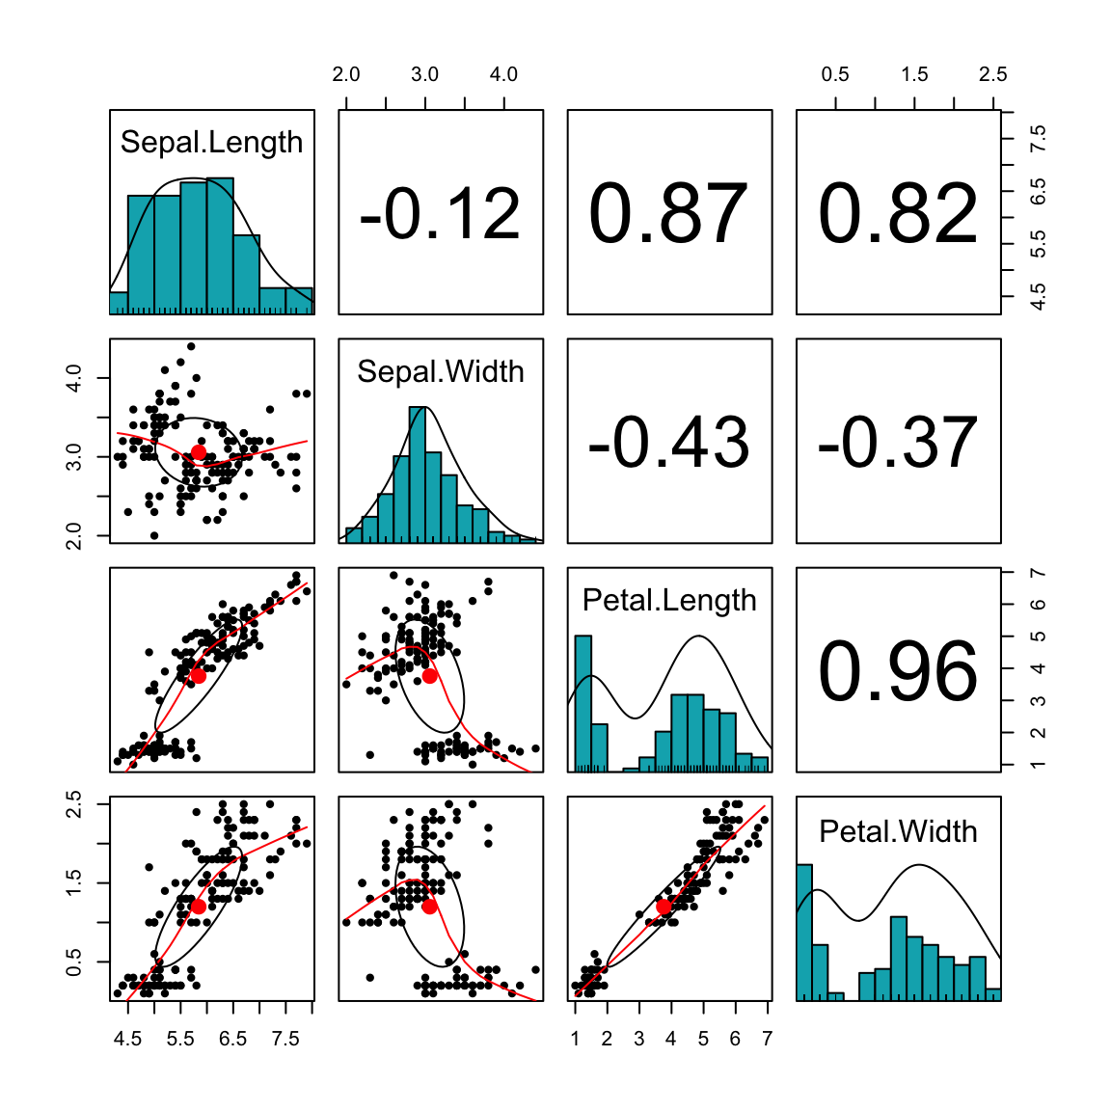
Explore Data - Collinearity
Collinearity happens when predictors are strongly correlated with each other
Drop redundant variables,
Combine them into an index or principal component
Re‑specify the model so each predictor has a clearer role (record rationale!)
Toolbox
Correlation heatmap; scatterplot matrix; VIF table

Slide 28
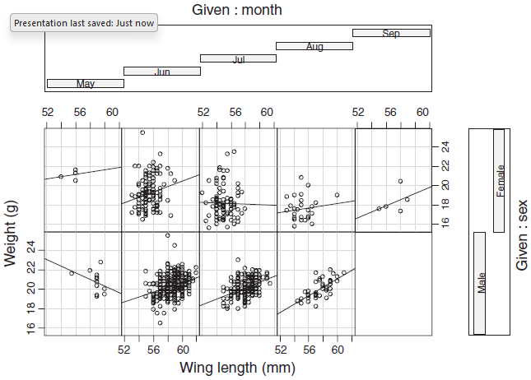
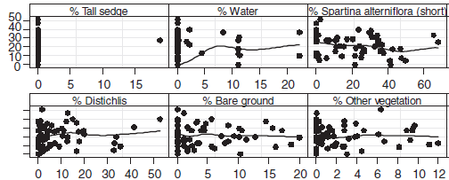
Explore Data – Relationships / Interactions
Relationships between response and each covariate
Interactions between 3+ variables
Toolbox
(Multi-panel) scatterplots; conditional boxplots; coplots

Slide 29
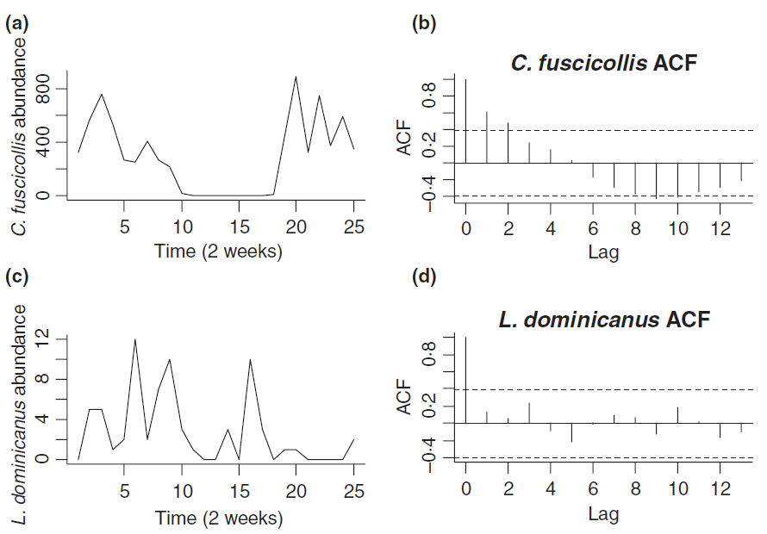
Explore Data - Independence / Clustering
Grouping: subjects, sites, time points
Plots by group / over time
Need for random effects or correlation structures?
Toolbox
Spaghetti plots; grouped box/dotplots; colored scatter; maps

Slide 30
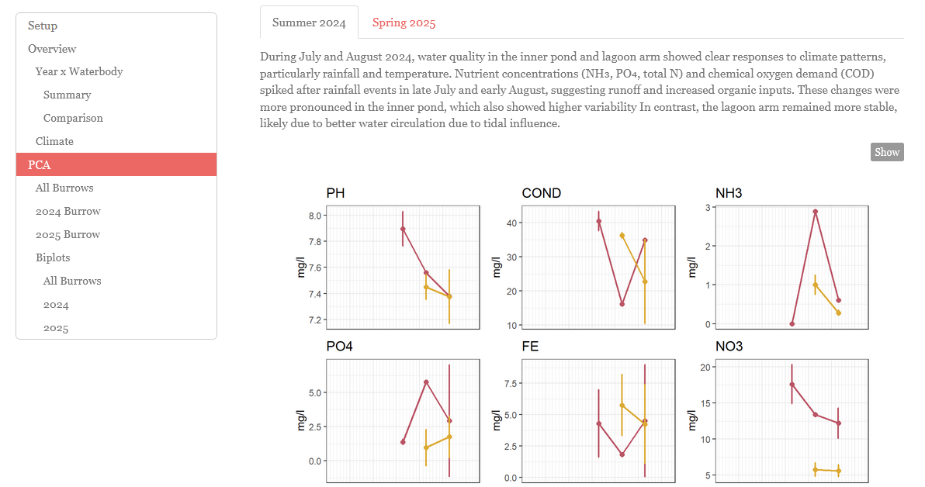
Good habits & Summary
Document your decisions
Keep an “exploration log”
what you plotted, anomalies you saw, what you changed, and why
Separate exploration vs confirmatory testing
Share code, diagnostics, rationale
Summary
Visualize first, model second
Go through the checklist
Use exploration to improve, not “game” statistics
Toolbox
Rmarkdown, R/Jupyter notebooks; saved plot grids; narrative logs

Slide 31
Step 1. Construct a statistical model to test your hypothesis
1. Construct a statistical model to test your hypothesis.
Linear model: y ~ x1 + x2 + x1:x2
Random effects?
Distribution? Gaussian okay or generalized model?
Notes:
Jake start?

Slide 32
Step 1. Construct a statistical model to test your hypothesis
Linear model: y_{i} ~ μ + β + e_{i}
Residual variation or error
Response variable
mean
Parameter estimate to change the mean based on some variable
(ie. slopes or intercepts)

Slide 33
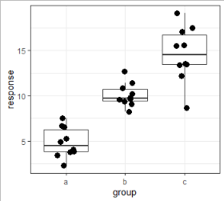
Step 1. Construct a statistical model to test your hypothesis
“Linear regression”: y_{i} ~ B₀ + B₁X + e_{i}
“ANOVA” model: y_{ij} ~ B₀ + β_{j} + e_{ij}
intercept
slope
resid
intercept
resid
Adjustment to intercept for each group
Notes:
ANOVA - Analysis of Variance

Slide 34
ANOVA as a linear model
“ANOVA” model: y_{ij} ~ B₀ + β_{j} + ε_{ij}
y_{ij} is the observation for individual i in group j
B₀ is the mean for the first (alphabetical) group
B_{j} is the mean for group j
e_{ij} is how far each obs is from its group mean
or the random variation in the data
Follows a normal distribution

Slide 35
ANOVA as a linear model
“ANOVA” model: y_{ij} ~ B₀ + β_{j} + ε_{ij}
y_{ij} is the observation for individual i in group j
B₀ is the mean for the first (alphabetical) group
B_{j} is the mean for group j
e_{ij} is how far each obs is from its group mean
or the random variation in the data
Follows a normal distribution
~B
~W

Slide 36
ANOVA as a linear model
“ANOVA” model: y_{ij} ~ B₀ + β_{j} + ε_{ij}
y_{ij} is the observation for individual i in group j
B₀ is the mean for the first (alphabetical) group
B_{j} is the mean for group j
e_{ij} is how far each obs is from its group mean
or the random variation in the data
Follows a normal distribution
~B (ie. how different the group means are)
~W (ie. how much var w/in group)

Slide 37
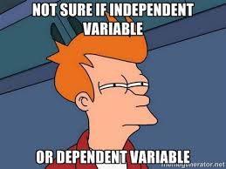
Questions ???
Materials and code:
Notes:
Phil

Slide 38
Linear mixed models
“ANOVA” model: y_{ij} ~ B₀ + β_{i} + e_{ij}
“RCBD”: y_{ij} ~ B₀ + β_{i} + α_{j} + e_{ij}
response
Random effect (ie. random intercepts for blocks)
Predictor variable or fixed effects (ie. different intercepts for treatment means)
Notes:
RCBD – random complete block design

Slide 39
Fixed vs. random effects?
Fixed effects
Random effects

Slide 40
Fixed vs. random effects?
Fixed effects
Random effects
Usually the factor(s) of interest in study (or covariates)
Same anywhere you do it
Values are meaningful and not exchangeable
Represent all possible levels of a factor (of interest)
Same for continuous variables
Conclusions restricted to those levels (group effects)

Slide 41
Fixed vs. random effects?
Fixed effects
Random effects
Usually the factor(s) of interest in study (or covariates)
Same anywhere you do it
Values are meaningful and not exchangeable
Represent all possible levels of a factor (of interest)
Same for continuous variables
Conclusions restricted to those levels (group effects)
Usually not the focus of study
Levels (categories) could be exchanged/substituted (eg. Individuals or blocks)
Represent a (random) sample of a larger set of levels
Can extrapolate conclusions to the larger sample (population level)
Different statistical properties

Slide 42
Random effects in experiments vs. observational studies
Much more control in experiments
Less control in observation surveys
Depends on data type/structure/
Pseudo-replication can be a problem in both

Slide 43
Benefits of blocking
Blocks are formed so that treatments within blocks are as homogenous as possible
Treatments randomly assigned within blocks
Used to reduce variation among experimental units
Allows to account for variation from block-to-block
Ensures interspersion among treatments
Can account for pseudo-replication (when present)

Slide 44
Rules of thumb about random effects
Sometimes it’s a judgement call of whether something should be fixed or random
Random effects should have at least 5 levels (and typically much more)
5+ blocks, 5+ populations, 5+ clutches
Each level of a random effect should have >3 observations
For most levels
Ok if a few levels have only a few observations
Should be relatively balanced among levels (but not perfectly)
Harrison et al. (2018), A brief introduction to mixed effects modelling and multi-model inference in ecology. PeerJ 6:e4794; DOI 10.7717/peerj.4794

Slide 45
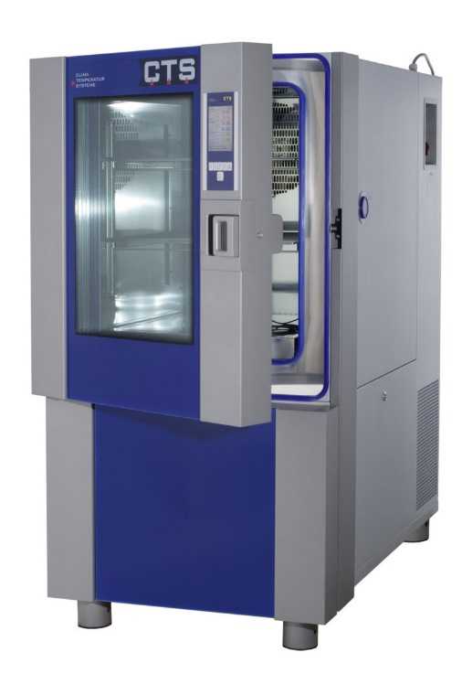

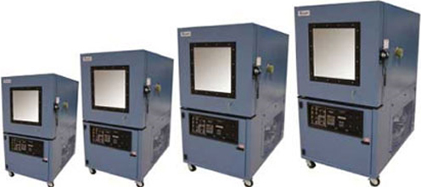
Examples of blocks
Chambers or tanks

Slide 46
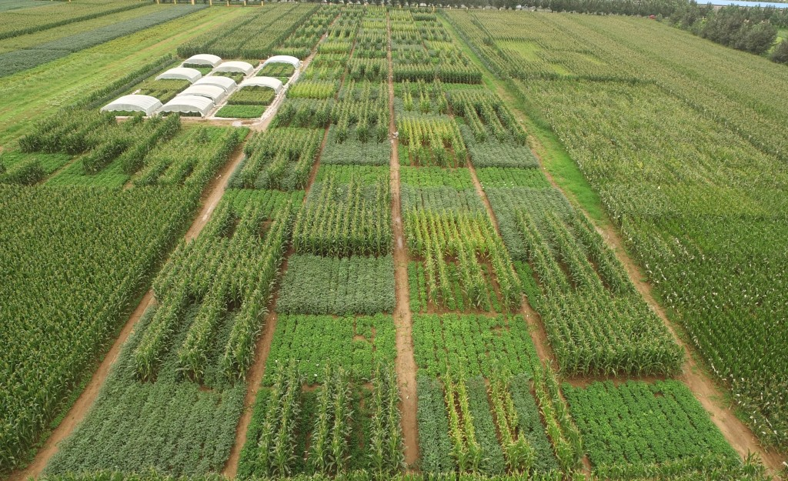
Examples of blocks
Fields

Slide 47
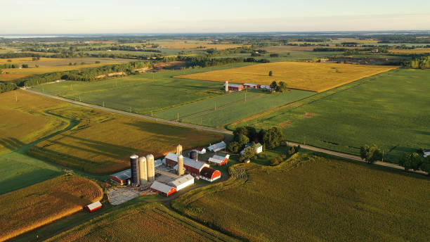
Examples of blocks
Farms

Slide 48



Examples of blocks
Parent – siblings all similar to each other

Slide 49

Examples of blocks
Individuals/subjects
Repeated measures
PRE
POST

Slide 50
Examples of blocks
Individuals/subjects
Repeated measures
Time 1
Time 2
Time 3

Slide 52
Which of the following would be characteristics typical of a FIXED effect in a statistical model? (select all that apply)
A factor of direct interest hypothesized to affect your response variable
A factor not of direct interest to the study which might have an unintended effect on your response variable
Values or levels are meaningful and the same anywhere you conducted the experiment
Values or levels could be exchanged or substituted
Values or levels represent a random subset of possible levels of the factor
Conclusions are restricted to the levels imposed
Conclusions can be extrapolated to the larger population

Slide 53
Which of the following would be characteristics typical of a FIXED effect in a statistical model? (select all that apply)
A factor of direct interest hypothesized to affect your response variable
A factor not of direct interest to the study which might have an unintended effect on your response variable
Values or levels are meaningful and the same anywhere you conducted the experiment
Values or levels could be exchanged or substituted
Values or levels represent a random subset of possible levels of the factor
Conclusions are restricted to the levels imposed
Conclusions can be extrapolated to the larger population

Slide 54
Which of the following would be characteristics typical of a RANDOM effect in a statistical model? (select all that apply)
A factor of direct interest hypothesized to affect your response variable
A factor not of direct interest to the study which might have an unintended effect on your response variable
Values or levels are meaningful and the same anywhere you conducted the experiment
Values or levels could be exchanged or substituted
Values or levels represent a random subset of possible levels of the factor
Conclusions are restricted to the levels imposed
Conclusions can be extrapolated to the larger population

Slide 55
Which of the following would be characteristics typical of a RANDOM effect in a statistical model? (select all that apply)
A factor of direct interest hypothesized to affect your response variable
A factor not of direct interest to the study which might have an unintended effect on your response variable
Values or levels are meaningful and the same anywhere you conducted the experiment
Values or levels could be exchanged or substituted
Values or levels represent a random subset of possible levels of the factor
Conclusions are restricted to the levels imposed
Conclusions can be extrapolated to the larger population

Slide 56
Step 1. Construct a statistical model to test your hypothesis
Table of R functions for constructing linear models
R function | SAS proc | Type of model | Type of test | Distribution
lm() | Proc glm Proc anova Proc reg | Linear model | Regression, ANOVA, ANCOVA | Gaussian
lmer() | Proc mixed | Linear mixed-effects models | Blocked or split-plot ANOVAs, nested designs, repeated measures. | Gaussian
glmer() | Proc glimmix | Generalized linear mixed-effects models | Blocked or split-plot ANOVAs, nested designs, repeated measures. | Poisson, Binomial
glmmTMB() | Proc glimmix | Any type of linear models, including generalized linear (mixed) models | Blocked or split-plot ANOVAs, nested designs, repeated measures. | Poisson, Binomial, Gamma, and many others
Notes:
Jake end?

Slide 57

Break
Materials and code:
Notes:
Allan

Slide 58
Step 2. Check model assumptions
Notes:
Phil start

Slide 59
Assumptions of linear models
Response variable errors (ie. residuals) normally distributed
Residuals should be normally distributed
Notes:
Data might not be “normally” distributed, but the residuals can be (or vice versa). Its only important that the residuals are normally distributed

Slide 60
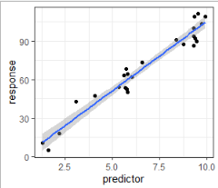
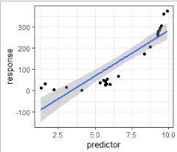
Assumptions of linear models
Response variable errors (ie. residuals) normally distributed
Linearity
Good
Bad

Slide 61
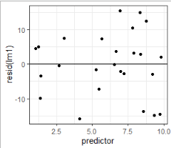
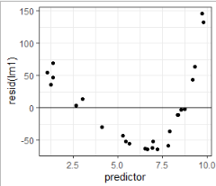
Assumptions of linear models
Response variable errors (ie. residuals) normally distributed
Linearity
Homoscedasticity
Good
Bad
Residuals should be evenly scattered around zero when plotted against the original predictor

Slide 62
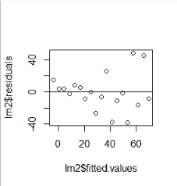
Assumptions of linear models
Response variable errors (ie. residuals) normally distributed
Linearity
Homoscedasticity
Good
Bad
Residuals should be evenly scattered around zero when plotted against the original predictor

Slide 63
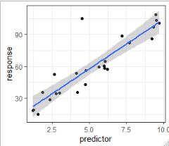
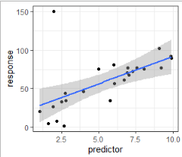
Assumptions of linear models
Response variable errors (ie. residuals) normally distributed
Linearity
Homoscedasiticy
Outliers
Good
Okay
Bad

Slide 64
Often data (and residuals) are not normally distributed

Slide 65

Why might we need to use non-normal distributions?
Linear models are reasonably robust to violations of the assumptions
Violations can affect
P-values
Standard errors
Parameter estimates
Generalized models provide a better fit to the data
P-values
Standard errors
Parameter estimates
Reviewers and editors expect it

Slide 66
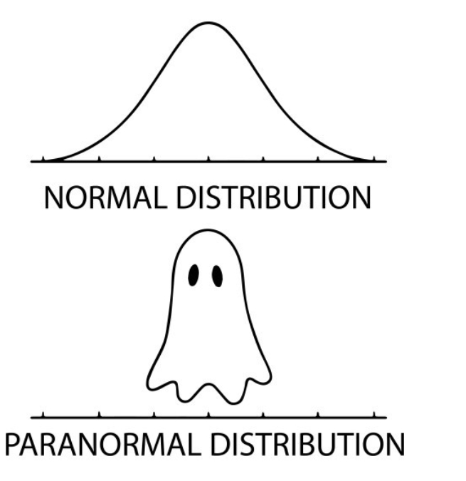
Questions ???
Notes:
Phil

Slide 67
What are “generalized” models?
Linear models that allow for more flexible error distributions
Parameters estimated via maximum likelihood (not least squares)
Model components
Linear predictor formula ( y ~ x )
Error distribution (usually exponential family)
Link function: links distribution to linear predictor formula
ie. Transforms error distribution to linear
Generalized linear mixed model
Allows fixed and random effects

Slide 68
Generalized linear mixed models
Linear model: y_{ij} ~ μ + β_{i} + ε_{ij}
Linear mixed model: y_{ij} ~ μ + α_{i} + β_{j} + ε_{ij}
Generalized linear mixed model: log(y_{ij}) ~ μ + α_{i} + β_{j} + ε_{ij}

Slide 69
Poisson distribution - assumptions
Discrete probability distribution
Integers: number of events (per unit of time or space; ie. rate)
Events occur randomly
Events are independent
Parameters
λ = mean = variance
Link function = log

Slide 70
Poisson linear model
Parameters
Intercept
Slope
log(y_{i}) ~ β₀ + β₁X_{i}
Response variable
Predictor variable
Data

Slide 71
Poisson linear model
Parameters
Intercept
Slope
Link function:
Relates x to log(y) on linear scale
Works on predicted values (λ_{i})
Doesn’t transform raw data
log(λ_{i}) ~ β₀ + β₁X_{i}
Response variable
(predicted)
Predictor variable
Data

Slide 72
Poisson linear model
log(λ_{i}) ~ β₀ + β₁X_{i}
=
λ_{i} ~ e^{β0 + β1Xi}

Slide 73
Poisson linear model – example 1
Counts across temp (continuous, 1 to 30):
log(λ_{i}) ~ β₀ + β₁X_{i}
yi ~ -0.3 + 0.14*X_{i}
log(λ_{i}) ~ -0.94 + 0.08*X_{i}
λ_{i} ~ e(-0.94 + 0.08*X_{i})

Slide 74
Poisson linear model – example 1
Counts across temp (continuous, 1 to 30):
log(λ_{i}) ~ β₀ + β₁X_{i}

Slide 75
Common distributions
Normal (gaussian)
Continuous numeric
Parameters
Mean
Variance (SD)
Link = identity (none)
Notes:
Jake start here

Slide 76
Common distributions
Normal (gaussian)
Continuous numeric
Parameters
Mean
Variance (SD)
Link = identity (none)
Negative binomial
Counts
Parameters
mu (mean)
phi (precision)
Inverse of dispersion
Link = log

Slide 77
Common distributions
Normal (gaussian)
Continuous numeric
Parameters
Mean
Variance (SD)
Link = identity (none)
Negative binomial
Counts
Parameters
mu (mean)
phi (precision)
Inverse of dispersion
Link = log
Binomial
Proportions
Binary or ratio
Parameters
Probability
# trials
Link = logit
Prob = 0.20

Slide 78
Common distributions
Normal (gaussian)
Continuous numeric
Parameters
Mean
Variance (SD)
Link = identity (none)
Negative binomial
Counts
Parameters
mu (mean)
phi (precision)
Inverse of dispersion
Link = log
Binomial
Proportions
Binary or ratio
Parameters
Probability
# trials
Link = logit
Prob = 0.20

Slide 79
Negative binomial distribution - assumptions
Discrete probability distribution
Integers: number of events
Events occur randomly (follow Poisson distribution)
Account for “extra” variation (beyond poisson)
Parameters
μ = mean
φ = overdispersion parameter
lower values are more overdispersion
higher values converge to Poisson
Var = μ + μ² / φ
Link function = log

Slide 80
Common types of distributions
Distribution | Type of data | Overdisperion parameter? | Link
Gaussian | Continuous numeric variable | Yes | Identity
Log-normal | Continuous numeric variable | Yes | Identity
Poisson | Integers, counts | No | Natural log
Negative binomial | Integers, counts | Yes | Natural log
Binomial | Success/failure or presence/absence (binary), ratio | No | Logit, cloglog
Beta-binomial | Success/failure, presence/absence (binary), ratio | Yes | Logit, cloglog
Beta | Proportion (when the denominator is not known) | Yes | Logit
ordbeta | Proportion (when the denominator is not known), can have zero’s | Yes | Logit
Gamma | Positive continuous variable | Yes | Inverse, log
ziGamma | Positive continuous variable, can haze zero’s | Yes | log

Slide 81
What distribution best matches the data?
Description of data
Distribution
Concentrations of chemicals in the soil, most values are low (~0.1 ug/L) but some are high (5-10 ug/L)
Number of infected and uninfected aphids on plants
Percent damage on leaves caused by herbivore or pathogens
Number of thrips on a plants
Normal
Log-normal
Poisson
Negative binomial
Binomial
Beta
Gamma
Notes:
Jake end

Slide 82
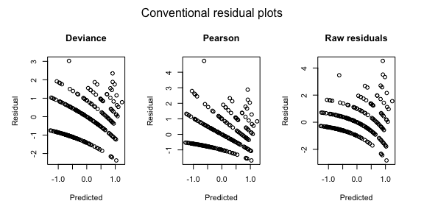
Step 2. Check GLM assumptions
“Conventional” residuals don’t work well for non-normal data
This figure shows residuals fit for count data assuming a Poisson distribution. The model (not shown) fits the data well, although the residuals look wonky.
Notes:
Phil start

Slide 83
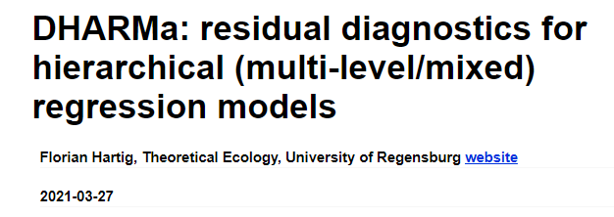
Step 2. Check GLM assumptions
“Regular” residuals often don’t work well for non-normal data
Simulated residuals offer a great diagnostic tool
DHARMa stands for “Diagnostics for HierArchical Regression Models”
https://cran.r-project.org/web/packages/DHARMa/vignettes/DHARMa.html

Slide 84
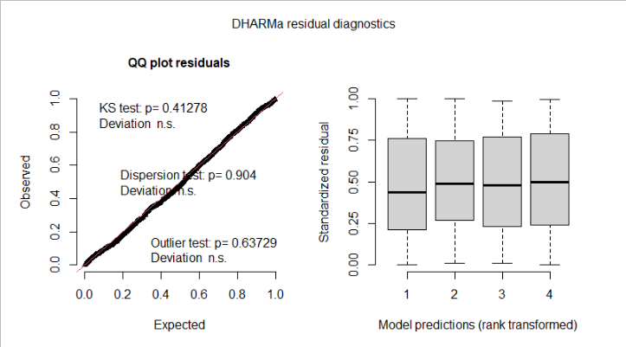
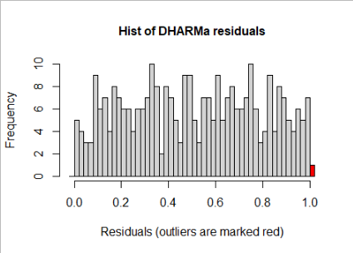
Step 2. Check GLM assumptions
“Regular” residuals often don’t work well for non-normal data
Simulated residuals offer a great diagnostic tool
https://cran.r-project.org/web/packages/DHARMa/vignettes/DHARMa.html

Slide 85
Reasons for deviations of residuals
Mis-specified model
Incorrect distribution (or potentially link function)
Missing fixed effect
Include additional covariates, if available
Check outliners in covariates or influential data points
Include quadratic term
Incorrect random-effect structure
Missing block or nestedness?
Incorrect order of nesting?
Overdispersion (return to this later)
Zero-inflation

Slide 86
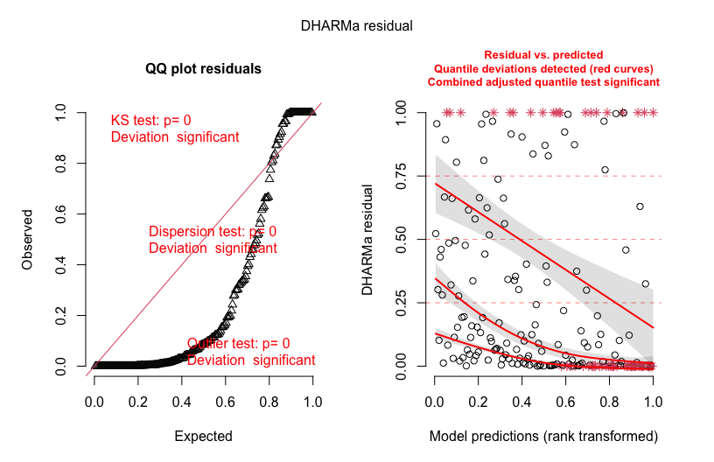
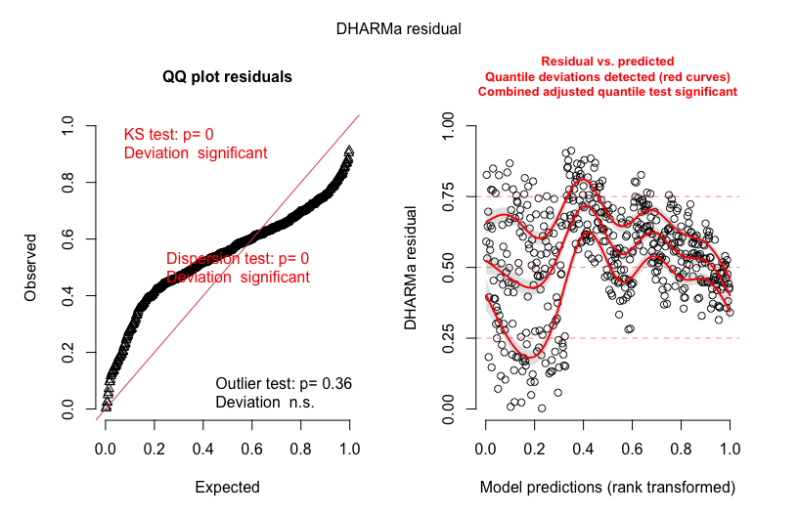
Step-by-step guide to analysis (post-data collection)
2. Check model assumptions
Bad residuals (overdispersion)
Bad residuals (wrong dist., overfitting, etc.)

Slide 87

What is overdispersion?
More variation in the data than expected based on the distribution
Poisson: λ = mean = variance
Most count data: variance > mean
Check: φ = Σ Pearson Resid^2/df
High values = more overdispersion
Alt: θ = overdispersion parameter
lower values are more overdispersion
higher values converge to Poisson
Need to correct!
Harrison 2014

Slide 88
Processes that generate overdispersion
Missing co-variates or random effects
Sampling (counting) errors
Non-independent (ie. aggregated) data
Environmental stochasticity
Many zeros (mixture of above, others, unknown)
Gelman and Hill 2007
Linden and Mantyniemi 2011 Ecology

Slide 89
What are consequences of overdispersion?
Confidence intervals too small
P-values too low, leading to Type I error
Biased parameter estimates

Slide 90
Step-by-step guide to analysis (post-data collection)
3. Check model parameters using summary()
Most useful for random effects and sometimes continuous variables (regression)
Function | Coefficients | Notes
lm() | Helpful to look at for slopes from regressions. Not that helpful for categorical variables. | Also helpful is R-square
lmer() | Helpful to look at for slopes from regressions. Not that helpful for categorical variables. Random effect variance components. | Singularity (VC=0) can be an issue.
glmmTMB() | Helpful to look at for slopes from regressions. Remember slopes predict transformed (via link function) values. Random effect variance components. | Singularity (VC=0) can be an issue. Output doesn’t provide resid deviance.

Slide 91
Step 3. Check random effects and model components
Investigate model with summary()
Random effects
Examine variance components
Fixed effects
Check fixed-effect signs, magnitudes, and uncertainty
Consider whether all predictors and interactions remain justified
Fit metrics (e.g., AIC)
Compare a set of plausible models
Check random effects
Not always necessary
Not all models have/need random effects and non-normal distributions
Very small/zero variance components suggest simplification
Singularity can be worth noting (very small VC is almost singular)
AIC for model comparison
smaller AIC = better fit–complexity trade-off
Notes:
Alex start

Slide 92
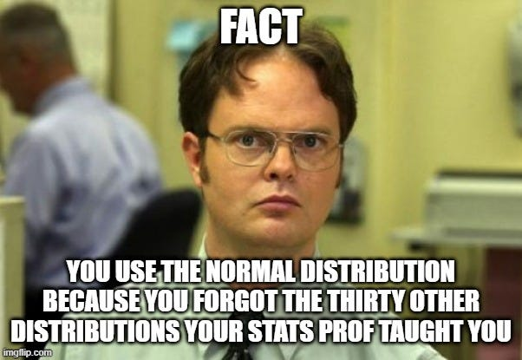
Questions ???
Materials and code:
Notes:
Allan

Slide 93
Step 4. Check significance of terms in model
Where do p-values come from?
Estimate parameter values (i.e., slopes or intercepts)
Calculate a test-statistic
Use a distribution to find your p-value
Alternative method is AIC model selection
Notes:
Allen start

Slide 94
Step 4. Check significance of terms in model
4. Check significance of terms in model
Most useful for categorical variables
Optional (for if using AIC model selection)
Function | ANOVA table function | Test
lm() | car::Anova(model, type=2) | Analysis of variance, F test
lmer() | lmerTest::anova(model) – best option Or car::Anova(model, type=2) | Analysis of variance, F test
glmmTMB() | car::Anova(model, type=2) | Analysis of deviance, Wald χ2 test

Slide 95


Methods to estimate parameters
Least squares
Maximum likelihood
Minimizes the sums of squares
$\sum{(y_{i}− \overline{y}}$)²
Maximizes the likelihood function
$ℒ\left(\text{β} | y\right)$

Slide 96




Least squares estimation
Minimizes the sums of squares
$\sum{(y_{i}− \overline{y}}$)²
β = slope; Fit represents $\overline{y}$
$$y_{i}− \overline{y}$$
β = 0
β = 1
β = -1
$$y_{i}− \overline{y}$$
y
y
y
$$y_{i}− \overline{y}$$
x
x
x

Slide 97

Maximum likelihood estimation
Maximizes the likelihood function
$ℒ\left(\text{β} | y\right)$: How likely is β given the observed data (y)
β = slope
β = -1
Likelihood of observing the data
y
x
-1
0
1
Parameter value

Slide 98

Maximum likelihood estimation
Maximizes the likelihood function
$ℒ\left(\text{β} | y\right)\text{: }\text{How} \text{likely}\text{ (}\text{probable}\text{) }\text{is} \text{β} \text{given} \text{the} \text{observed} \text{data}\text{ (}\text{y}\text{)}$
$\text{β}\text{ = }\text{slope}$
β = 0
Likelihood of observing the data
y
x
-1
0
1
Parameter value

Slide 99

Maximum likelihood estimation
Maximizes the likelihood function
$ℒ\left(\text{β} | y\right)\text{: }\text{How} \text{likely}\text{ (}\text{probable}\text{) }\text{is} \text{β} \text{given} \text{the} \text{observed} \text{data}\text{ (}\text{y}\text{)}$
$\text{β}\text{ = }\text{slope}$
β = 1
Likelihood of observing the data
y
x
-1
0
1
Parameter value

Slide 100

Maximum likelihood estimation
Maximizes the likelihood function
$ℒ\left(\text{β} | y\right)\text{: }\text{How} \text{likely}\text{ (}\text{probable}\text{) }\text{is} \text{β} \text{given} \text{the} \text{observed} \text{data}\text{ (}\text{y}\text{)}$
$\text{β}\text{ =} \text{slope}$
β = 2
Likelihood of observing the data
y
x
-1
0
1
Parameter value

Slide 101


Methods to estimate parameters
Least squares
Maximum likelihood
Minimizes the sums of squares
$\sum{(y_{i}− \overline{y}}$)²
β = slope or intercept adjust
Only works for normal data
Maximizes the likelihood function
$ℒ\left(\text{β} | y\right)$
β = slope or intercept adjust
Can be generalized to any distribution
β = 1

Slide 102
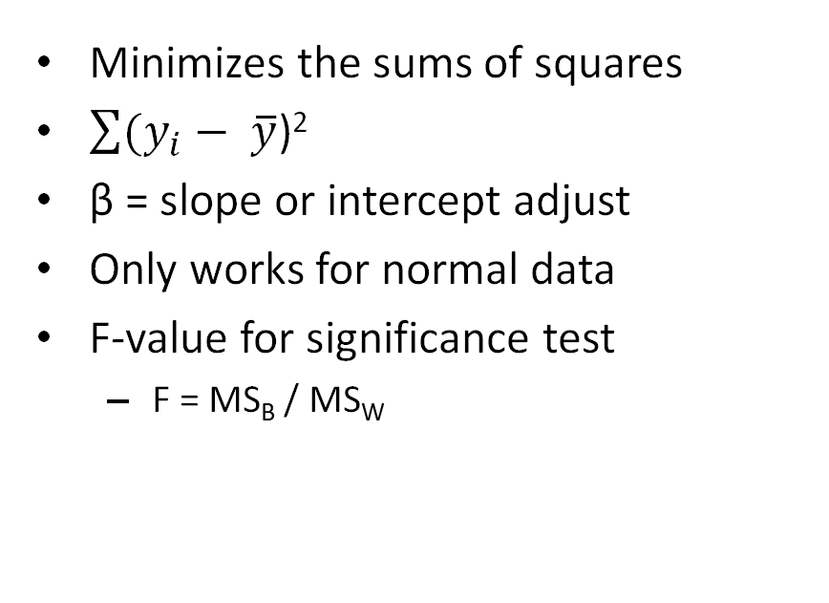
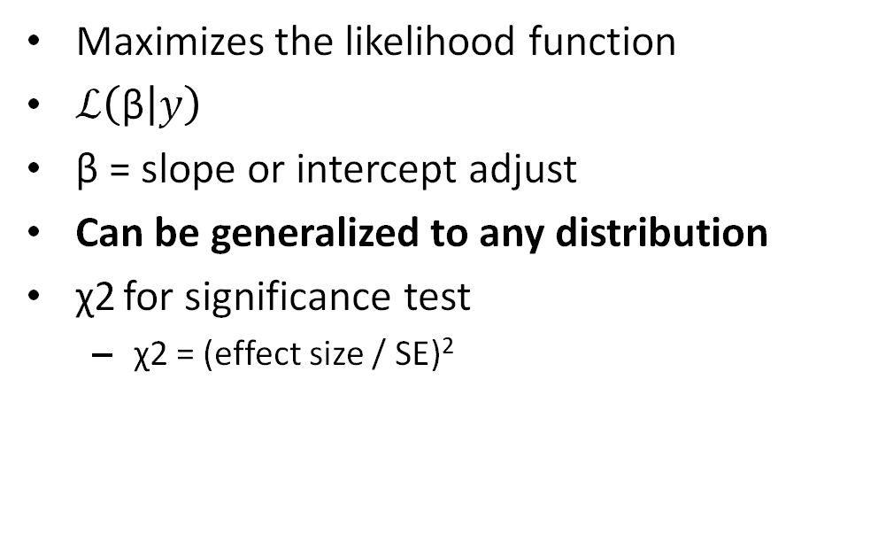
Methods to estimate parameters
Least squares
Maximum likelihood
Minimizes the sums of squares
$\sum{(y_{i}− \overline{y}}$)²
β = slope or intercept adjust
Only works for normal data
F-value for significance test
F = MS_{B} / MS_{W}
Maximizes the likelihood function
$ℒ\left(\text{β} | y\right)$
β = slope or intercept adjust
Can be generalized to any distribution
χ2 for significance test
χ2 = (effect size / SE)²
Notes:
MS come from the Sums of squares divided by the DF

Slide 103
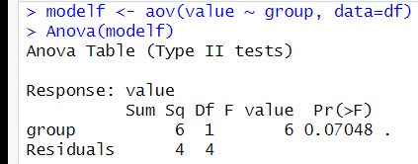
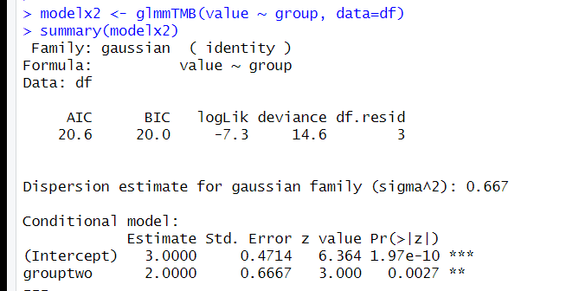

Methods to estimate parameters
Least squares
Maximum likelihood
Minimizes the sums of squares
$\sum{(y_{i}− \overline{y}}$)²
β = slope or intercept adjust
Only works for normal data
F-value for significance test
F = MS_{B} / MS_{W}
Maximizes the likelihood function
$ℒ\left(\text{β} | y\right)$
β = slope or intercept adjust
Can be generalized to any distribution
χ2 for significance test
χ2 = (effect size / SE)²

Slide 104
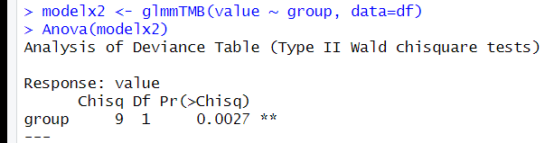
Methods to estimate parameters
Least squares
Maximum likelihood
Minimizes the sums of squares
$\sum{(y_{i}− \overline{y}}$)²
β = slope or intercept adjust
Only works for normal data
F-value for significance test
F = MS_{B} / MS_{W}
Maximizes the likelihood function
$ℒ\left(\text{β} | y\right)$
β = slope or intercept adjust
Can be generalized to any distribution
χ2 for significance test
χ2 = (effect size / SE)²

Slide 105
A very simple example of calculating a likelihood
Heads vs tails: Probability of getting a heads?
P = 0.5
Two flips, probability of getting two heads?
P(0.5) * P(0.5) = 0.25
What if we have an object with two sides (top, bottom) but we don’t know the probability of top vs bottom (probably not 50:50).
Toss object 10 times, we get 7 tops and 3 bottoms (ie. We collected data)
Log-likelihood: 7*log(p) + 3*log(1-p) = -6.1 when p=0.7
Maximum likelihood: iterative process to find the optimum (maximum)
Log-likelihood: 7*log(.5) + 3*log(1-.5) = -6.9

Slide 106
Step-by-step guide to analysis (post-data collection)
4a. Model selection with AIC
Function | AIC | Test
lm() | bbmle::AICtab MuMIn::model.sel | Model comparison
lmer() | bbmle::AICtab MuMIn::model.sel | Model comparison
glmmTMB() | bbmle::AICtab MuMIn::model.sel | Model comparison

Slide 107
After break
Worked example
Overview Steps 1-4
Step 5: Calculate group means
Step 6: Conduct contrasts
Step 7: Calculate R2
Step 8: Visualize data (if time permits)
Materials and code:

Slide 108
Step-by-step guide to analysis (post-data collection)
5. Estimate means and/or effect sizes
emmeans(model, ~Treatment)
Provides means and confidence intervals
For transformed response variables, either via link function (glm) or in model, you can back transform means
emmeans(model, ~Treatment, type=“response”)
When backtransforming with multiple random effects (ie. glmer), you may need to use bias.adj=T
emmtrends for slopes

Slide 109
Step-by-step guide to analysis (post-data collection)
6. Compare means using contrasts
emmeans(model, pairwise~Treatment)
emmeans(model, pairwise~Treatment | Slices)
emtrends(model, ~Treatment, var=“continuousvar”)
For slopes

Slide 110
Step-by-step guide to analysis (post-data collection)
7. Calculate R2
R2 from performance
r.squaredGLMM from MuMIn
Note these use the same reference, but r2 values differ (not sure why, need to look into…)

Slide 111


Step-by-step guide to analysis (post-data collection)
8. Visualize data
- Helpful for checking that parameters line up with raw plotted data, etc.

Slide 112


Troubleshooting with glmmTMB
Hessian matrix, what is it?
$$ℒ\left(\text{β} | y\right)$$
Likelihood of observing the data
-1
0
1
Parameter value
https://cran.r-project.org/web/packages/glmmTMB/vignettes/troubleshooting.html

Slide 113

Troubleshooting with glmmTMB
Hessian matrix, what is it?
When is it non-positive definite?
$$ℒ\left(\text{β} | y\right)$$
Likelihood of observing the data
Likelihood of observing the data
-1
0
1
-1
0
1
Parameter value
Parameter value
https://cran.r-project.org/web/packages/glmmTMB/vignettes/troubleshooting.html

Slide 114

Troubleshooting with glmmTMB
Hessian matrix, what is it?
When is it non-positive definite?
$$ℒ\left(\text{β} | y\right)$$
Likelihood of observing the data
Likelihood of observing the data
-1
0
1
-1
0
1
Parameter value
Parameter value
https://cran.r-project.org/web/packages/glmmTMB/vignettes/troubleshooting.html

Slide 115
Troubleshooting with glmmTMB
Model convergence problem; non-positive-definite Hessian matrix; NA values for likelihood/AIC/etc.
when a model is overparameterized (i.e. the data does not contain enough information to estimate the parameters reliably)
Or problematic covariate (skewed, outliers, etc.)
when a random-effect variance is estimated to be zero, or random-effect terms are estimated to be perfectly correlated ("singular fit": often caused by having too few levels of the random-effect grouping variable)
when zero-inflation is estimated to be near zero (a strongly negative zero-inflation parameter)
when dispersion is estimated to be near zero
when complete separation occurs in a binomial model: some categories in the model contain proportions that are either all 0 or all 1
https://cran.r-project.org/web/packages/glmmTMB/vignettes/troubleshooting.html

Slide 116


Materials and code:

